Slide 1
Study of Flow Convergence Time
flow 2
r₂ = B
2
rx
tx
r₁ = B
flow 1
1
3
tx
rx
flow 3
rx
tx
r₃ = B
Flow Convergence Time: Let t₀ be the time we start all flows. Let t₁ be the time that queue occupancy of three flows is around PFC threshold in related tx queues for the first time. We define t₁ - t₀ as the flow convergence time.

Slide 2
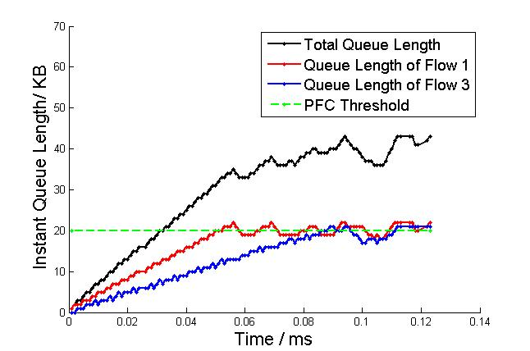
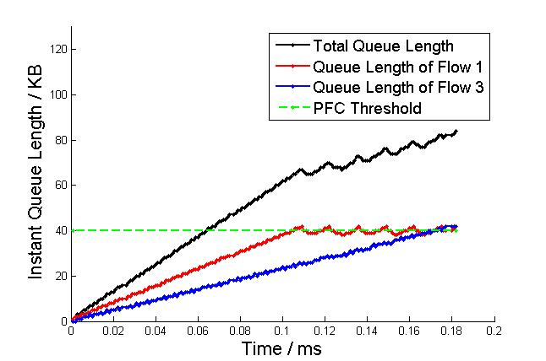
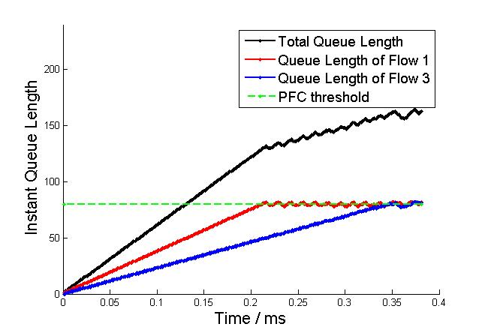
Flow Convergence Time - Exp1
Instant queue length of tx queue of switch 1:
PFC threshold= 20KB
PFC threshold= 40KB
PFC threshold= 80KB
Setting: link delay =0ms, link capacity = 8Gbps (1us to transmit a packet), start all three flows at time 0ms.
Observation: Flow convergence time is lineal to PFC threshold (e.g., ~0.08ms when PFC = 20KB, ~0.16ms when PFC = 40KB)

Slide 3
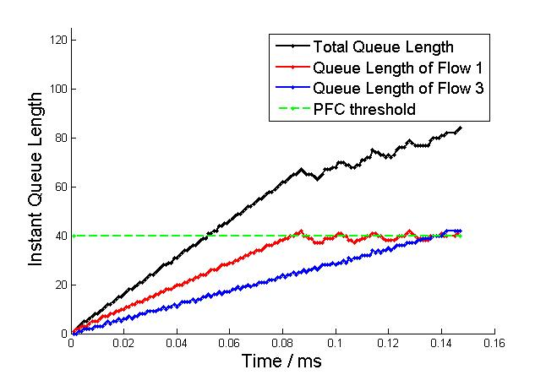
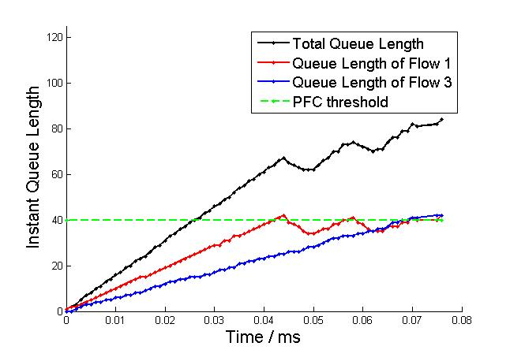
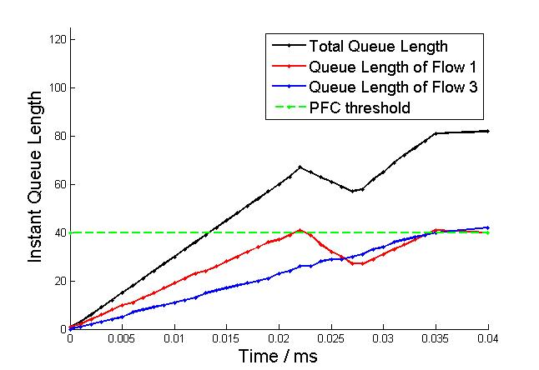
Flow Convergence Time – Exp2
Instant queue length of tx queue of switch 1:
Link capacity= 10Gbps
Link capacity= 20Gbps
Link capacity= 40Gbps
Setting: link delay =0ms, PFC threshold= 40KB (1us to transmit a packet), start all three flows at time 0ms.
Observation: Flow convergence time is lineal and inversely proportional to link capacity (e.g., ~0.13ms when link capacity = 10Gbps, ~0.065ms when link capacity = 20Gbps)

Slide 4
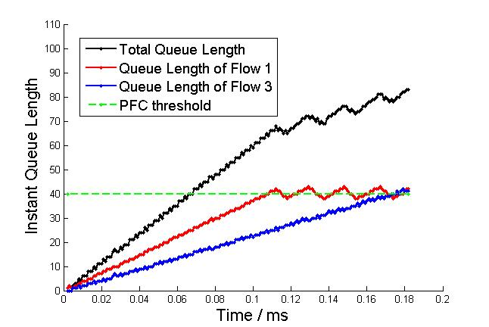
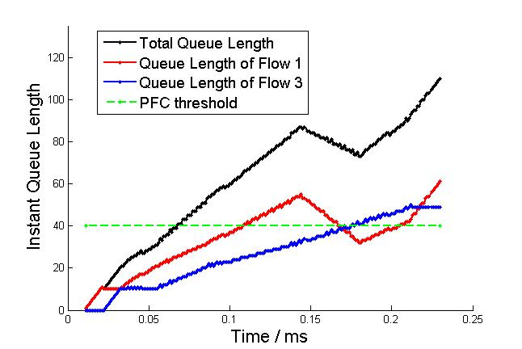
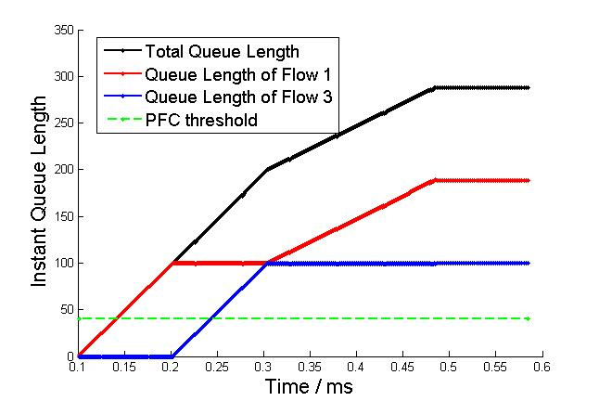
Flow Convergence Time – Exp3
Instant queue length of tx queue of switch 1:
Link delay =0.001ms
Link delay =0.01ms
Link delay =0.1ms
Setting: PFC threshold= 40KB, link capacity = 8Gbps (1us to transmit a packet), start all three flows at time 0ms.
Observation: Flows do not converge when link delay is very large (e.g., 0.1ms)

Slide 5
Impact of Extra Flows
flow 2
r₂ = B
2
K extra flows
rx
tx
K extra flows
r₁ = B
flow 1
1
3
tx
rx
flow 3
rx
tx
r₃ = B
In addition to flow 1, flow 2 and flow 3, we generate K extra flows to each link (i.e. K flows that go from switch 1 to switch 2, K flows from switch 2 to switch 3, K flows from switch 3 to switch 1.

Slide 6
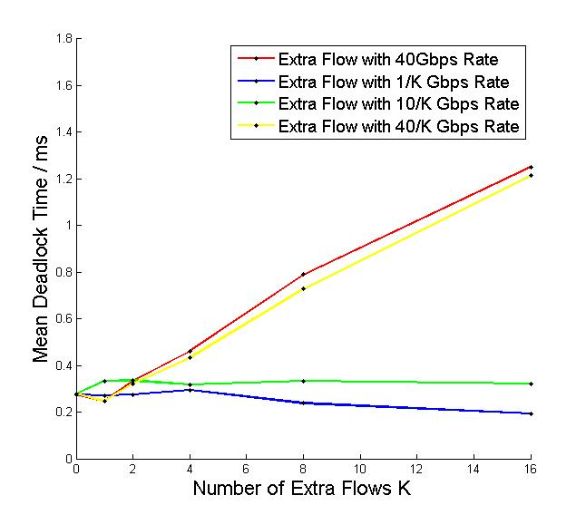
Simulation results – Exp1 & Exp 2
Setting:
Static PFC threshold 300KB.
Start flow 1, flow 2 and all extra flows at time 0ms, and start flow 3 at time 50ms.
When the sum rate of all extra flows is smaller than link capacity, i.e., 40Gbps, deadlock time will not go up as K goes up.

